Slide 1
Application of Neural Networks on Air Quality Update
Timothy Quah

Slide 2
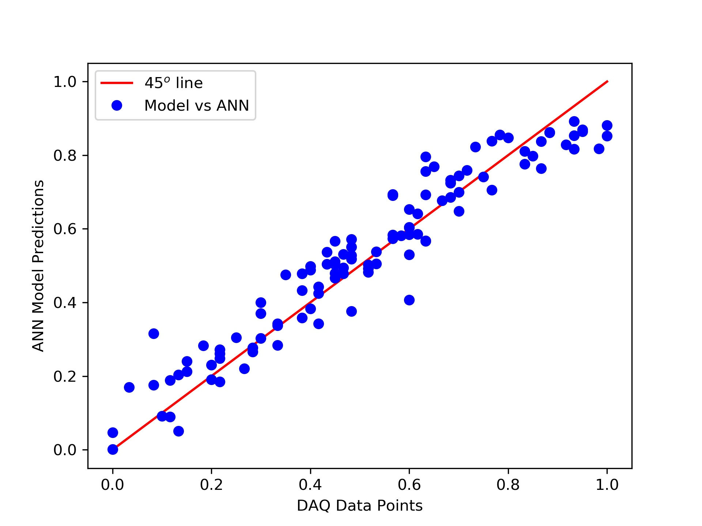
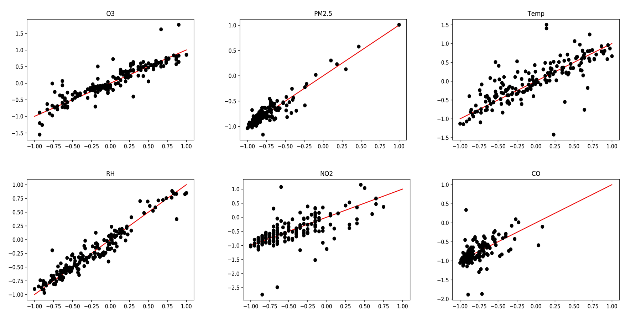



Where we left off last…
Training DAQ
Training Air U sensor on two weeks
Merging/Cleaning the datasets (AirU/DAQ)
Hawthorne
Rose Park

Slide 3
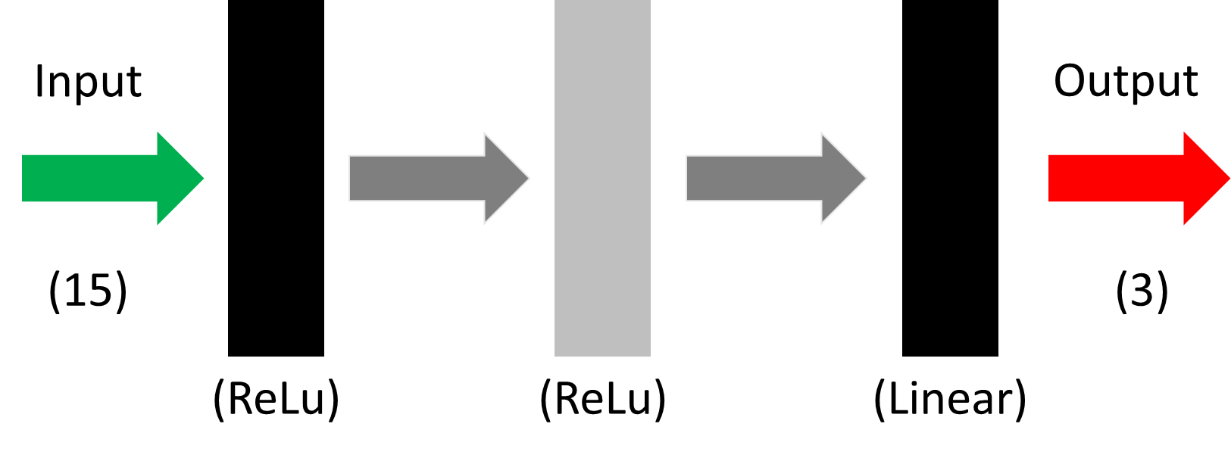
Neural Network Architecture
Similar to past except much bigger… and harder to visualize the architecture
Instead of 6 outputs we have reduced it to 3 outputs
Ozone
Nitrogen Dioxide
Carbon Monoxide

Slide 4
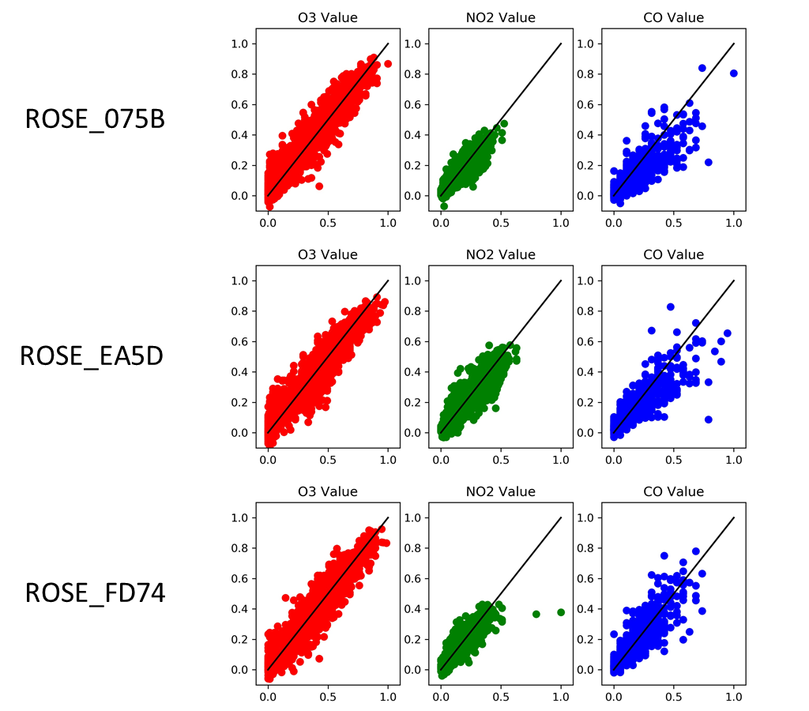
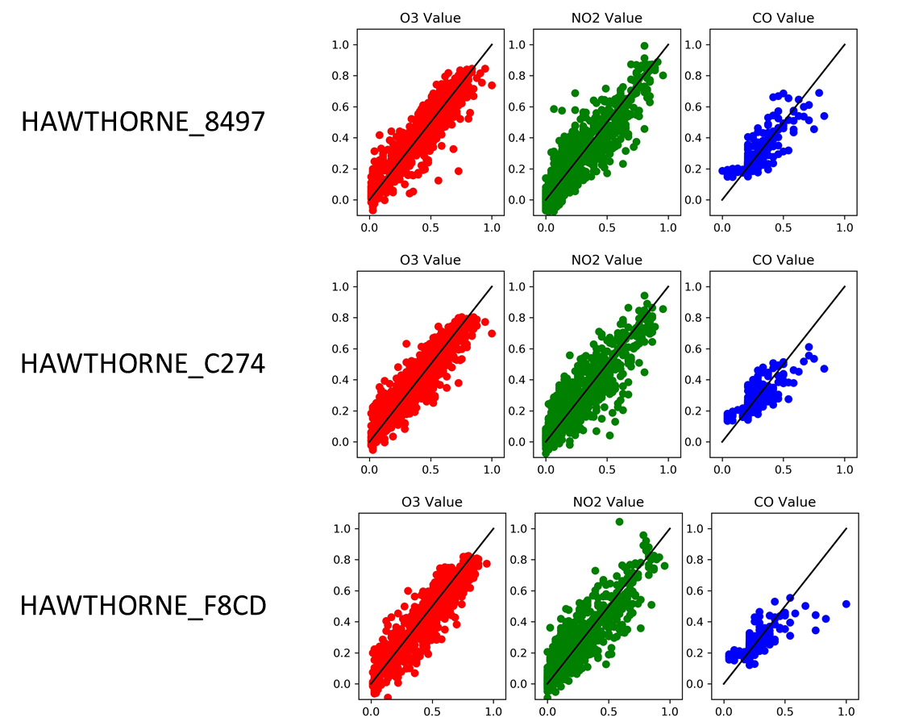
Local(Individual Sensor) Neural Networks
Note: Each Neural Network is trained using data from the specific sensor!

Slide 5
Local(Individual Sensor) Neural Networks
What if we apply the local sensors on the entire dataset?

Slide 6
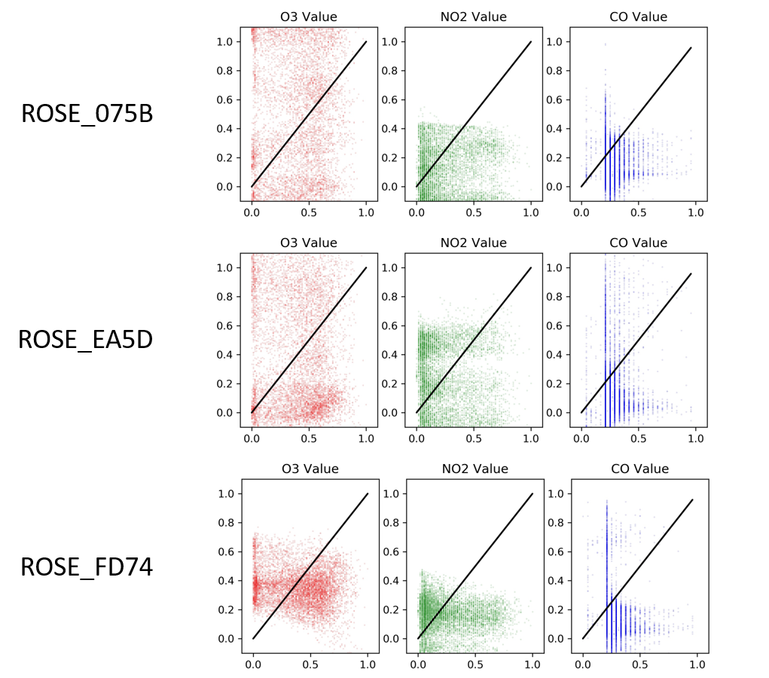
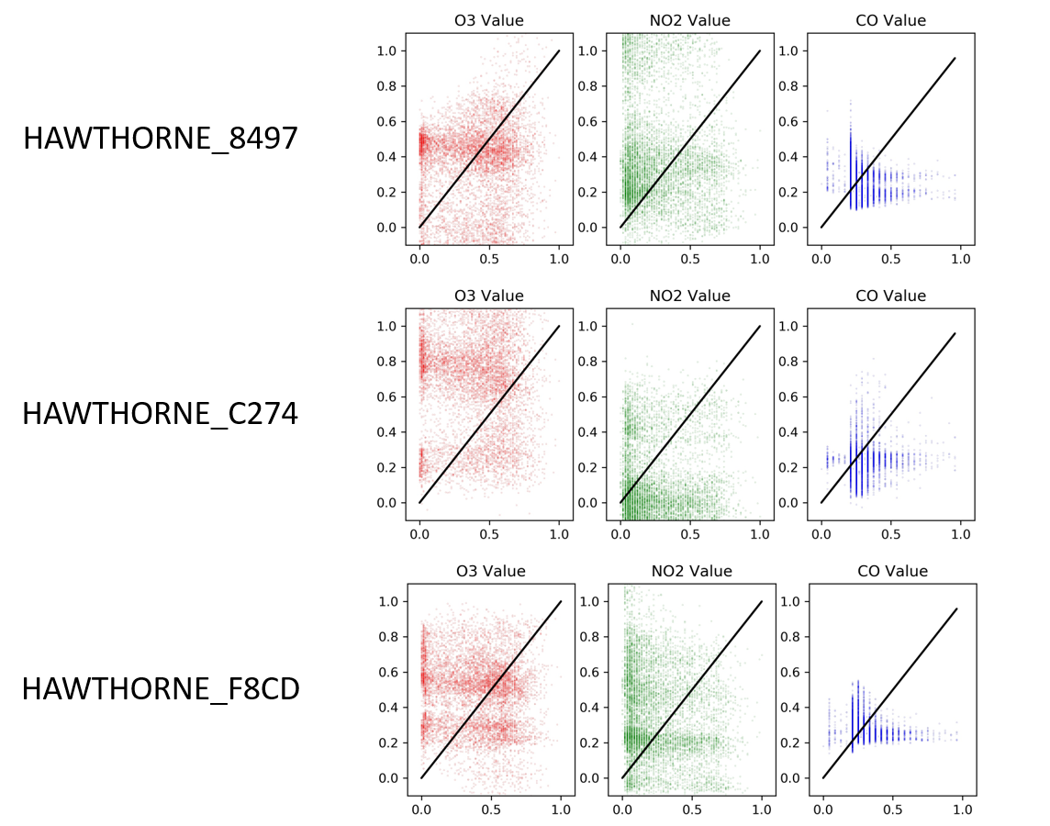
Local Neural Networks on the Whole Dataset
Quite Random…

Slide 7
Local(Individual Sensor) Neural Networks
Can we create a crossover chart (a chart that allows us to visualize each local neural network predictions on another sensor’s dataset)?

Slide 8
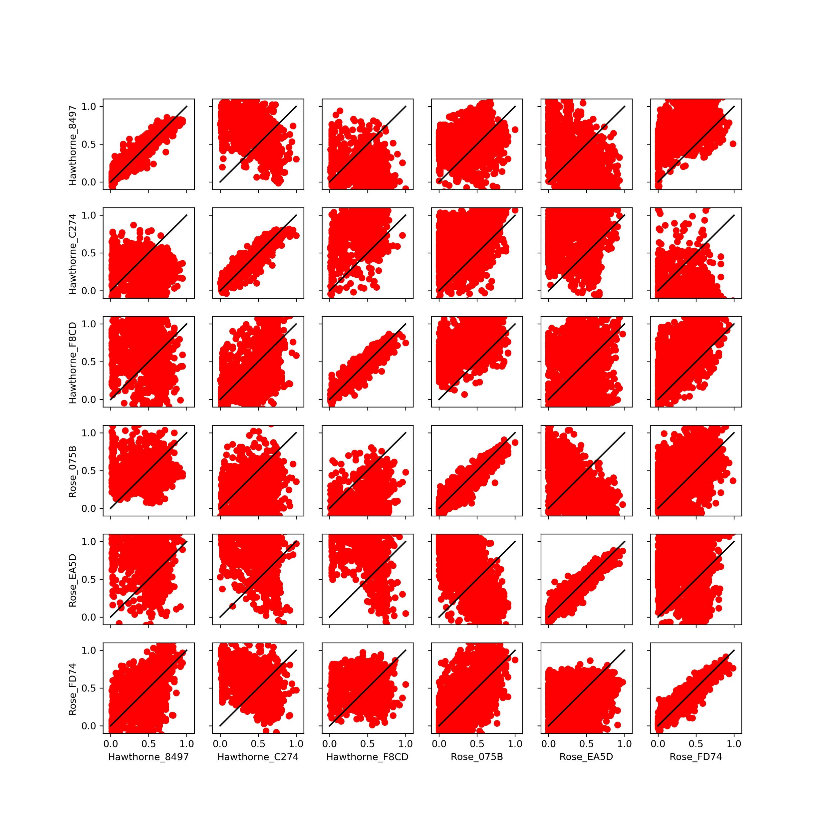
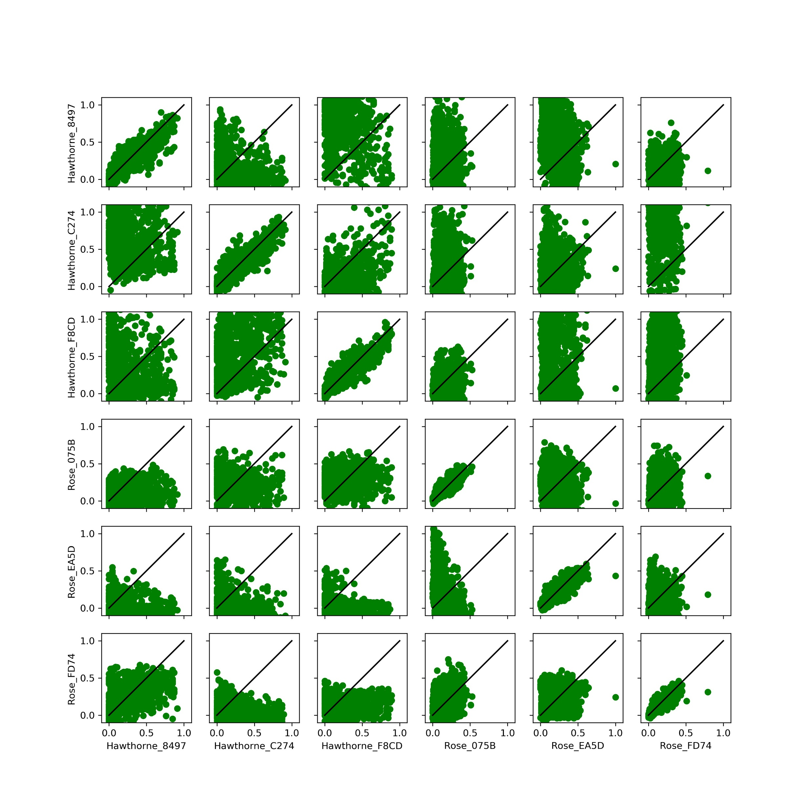
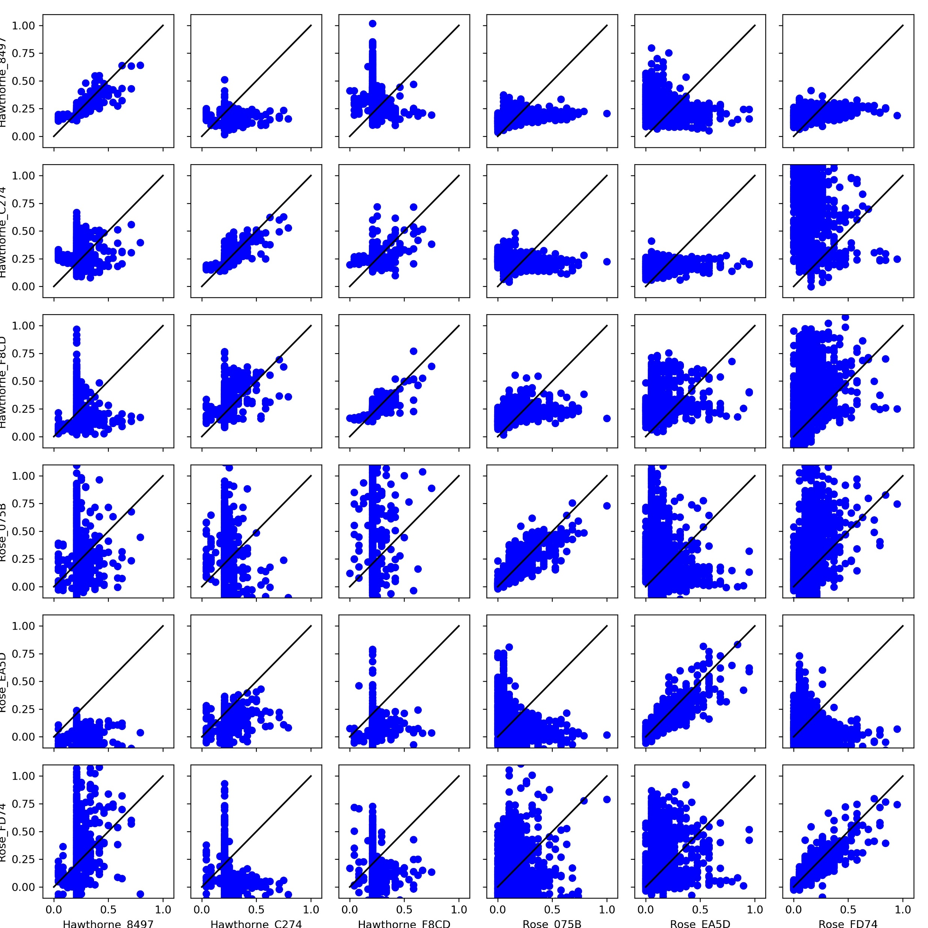
Local Neural Networks Crossover Chart
Issues with local normalization?
Maybe challenging to combine the neural networks

Slide 9
“Global Neural Network”
Can we create a single neural network that has all the data and maybe it can get past the differences in sensors?

Slide 10
Choosing Layer and Nodes Number
Trained various neural networks on the dataset and saved both error and R2 Value

Slide 11
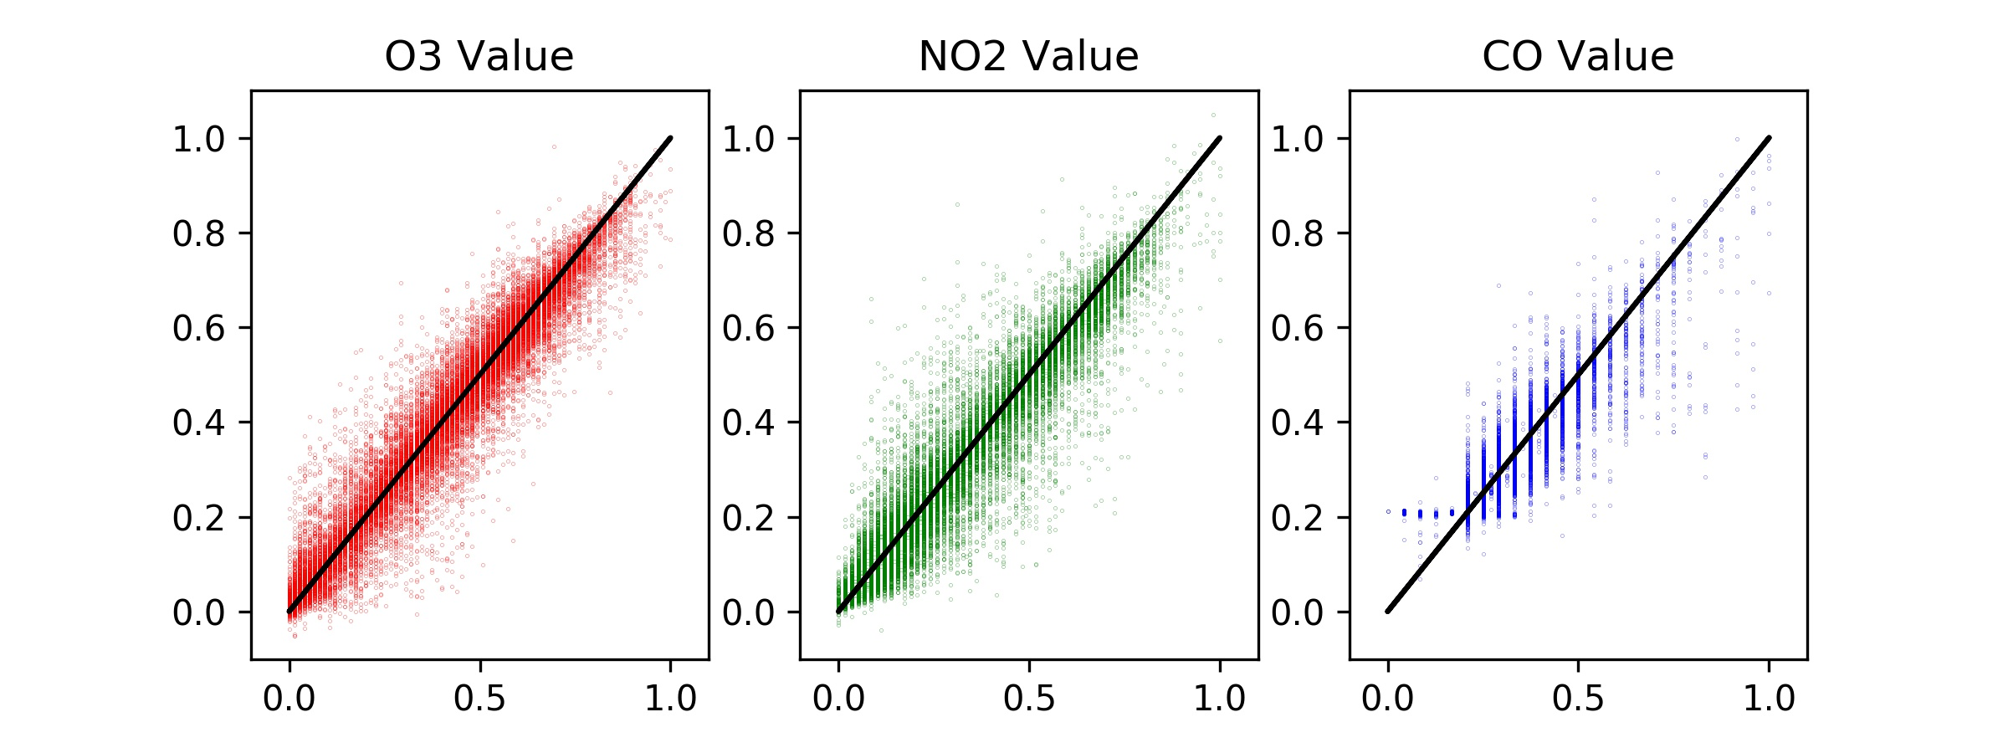
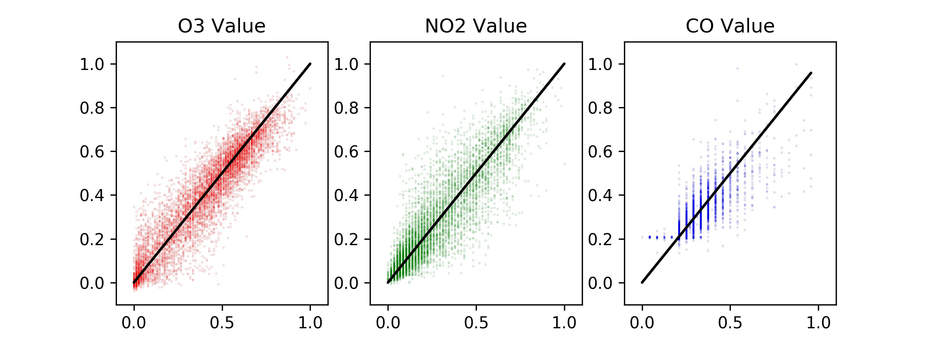
“Global Neural Network”
Interesting?

Slide 12
Loss Function?
Mean Squared Error (MSE)
Mean Absolute Error (MAE)
Not Much Different!

Slide 13
“Global Neural Network”
Can we visualize the contribution of each input parameter on the Neural Network’s output?
We normalize the dataset from 0 to 1
If we change one parameter at a time meaning and keep the rest at 0.5 (middle of normalization) can we visualize what the neural network is doing?

Slide 14
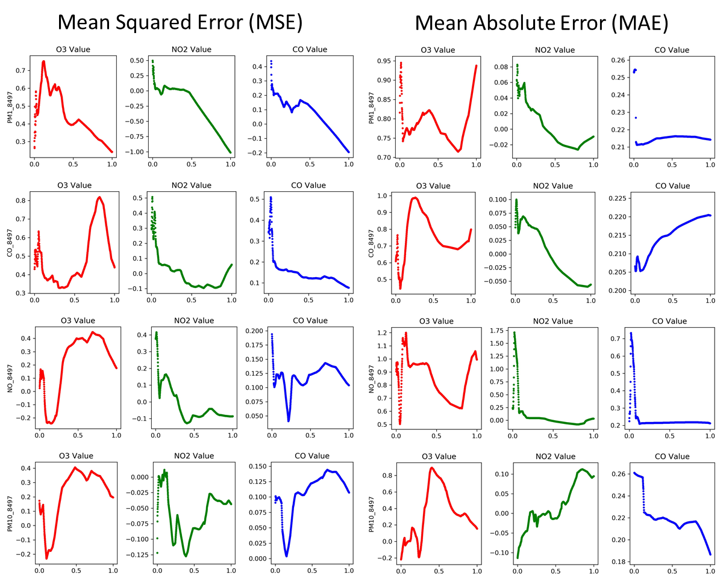
Ignore the _8497 this is just showing that it is a AirU sensor vs DAQ

Slide 15
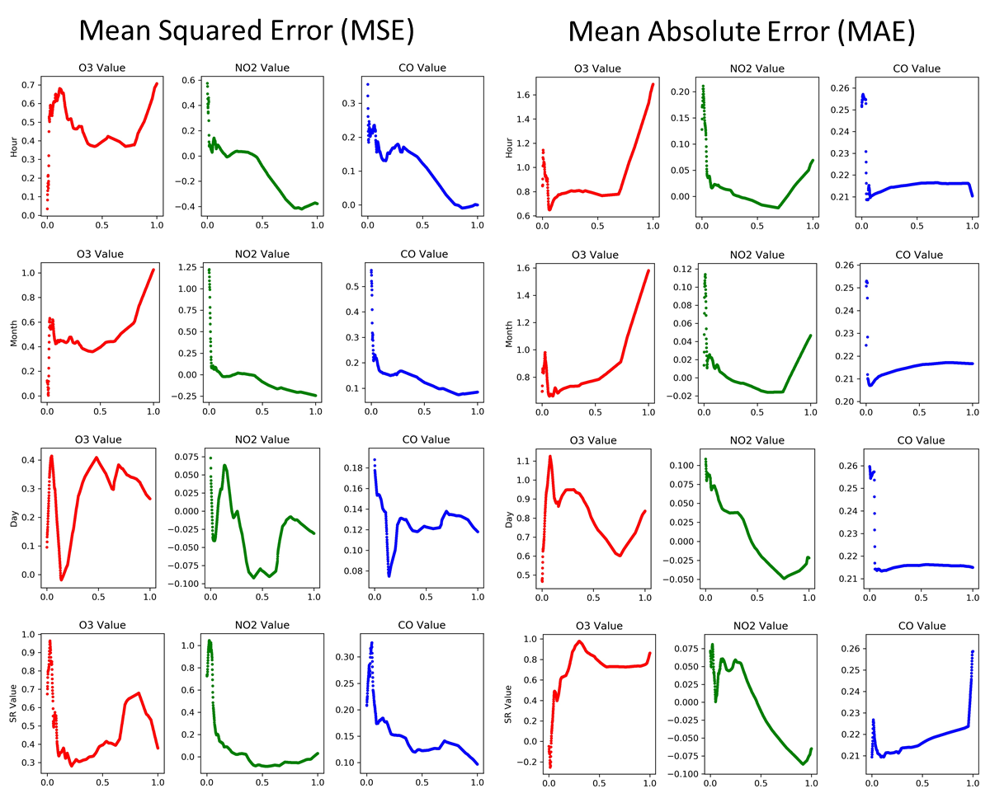

Slide 16
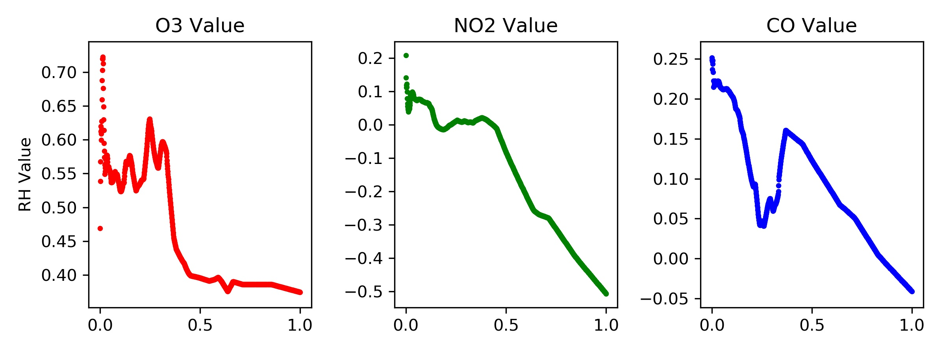
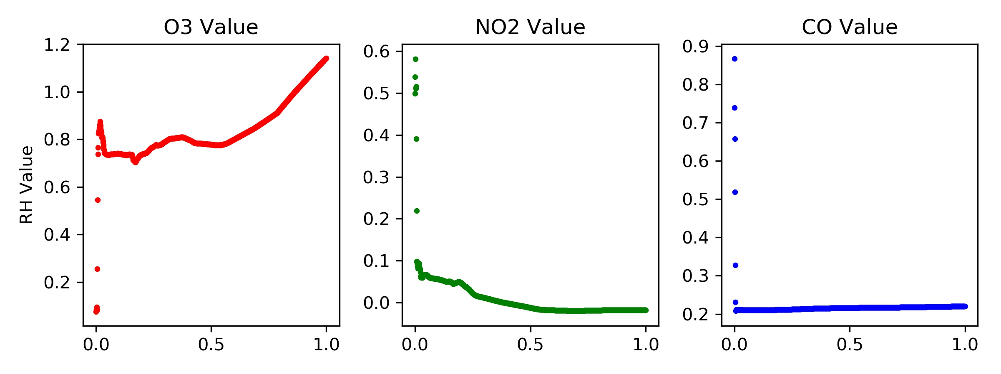
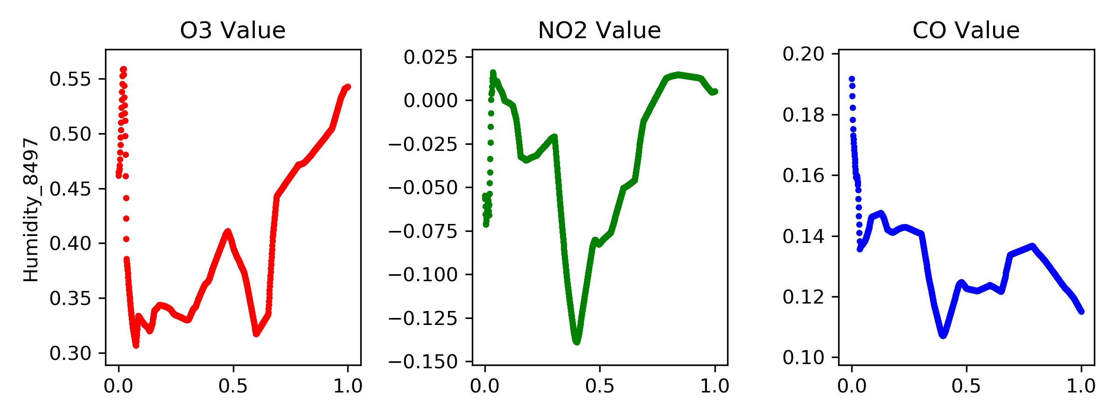
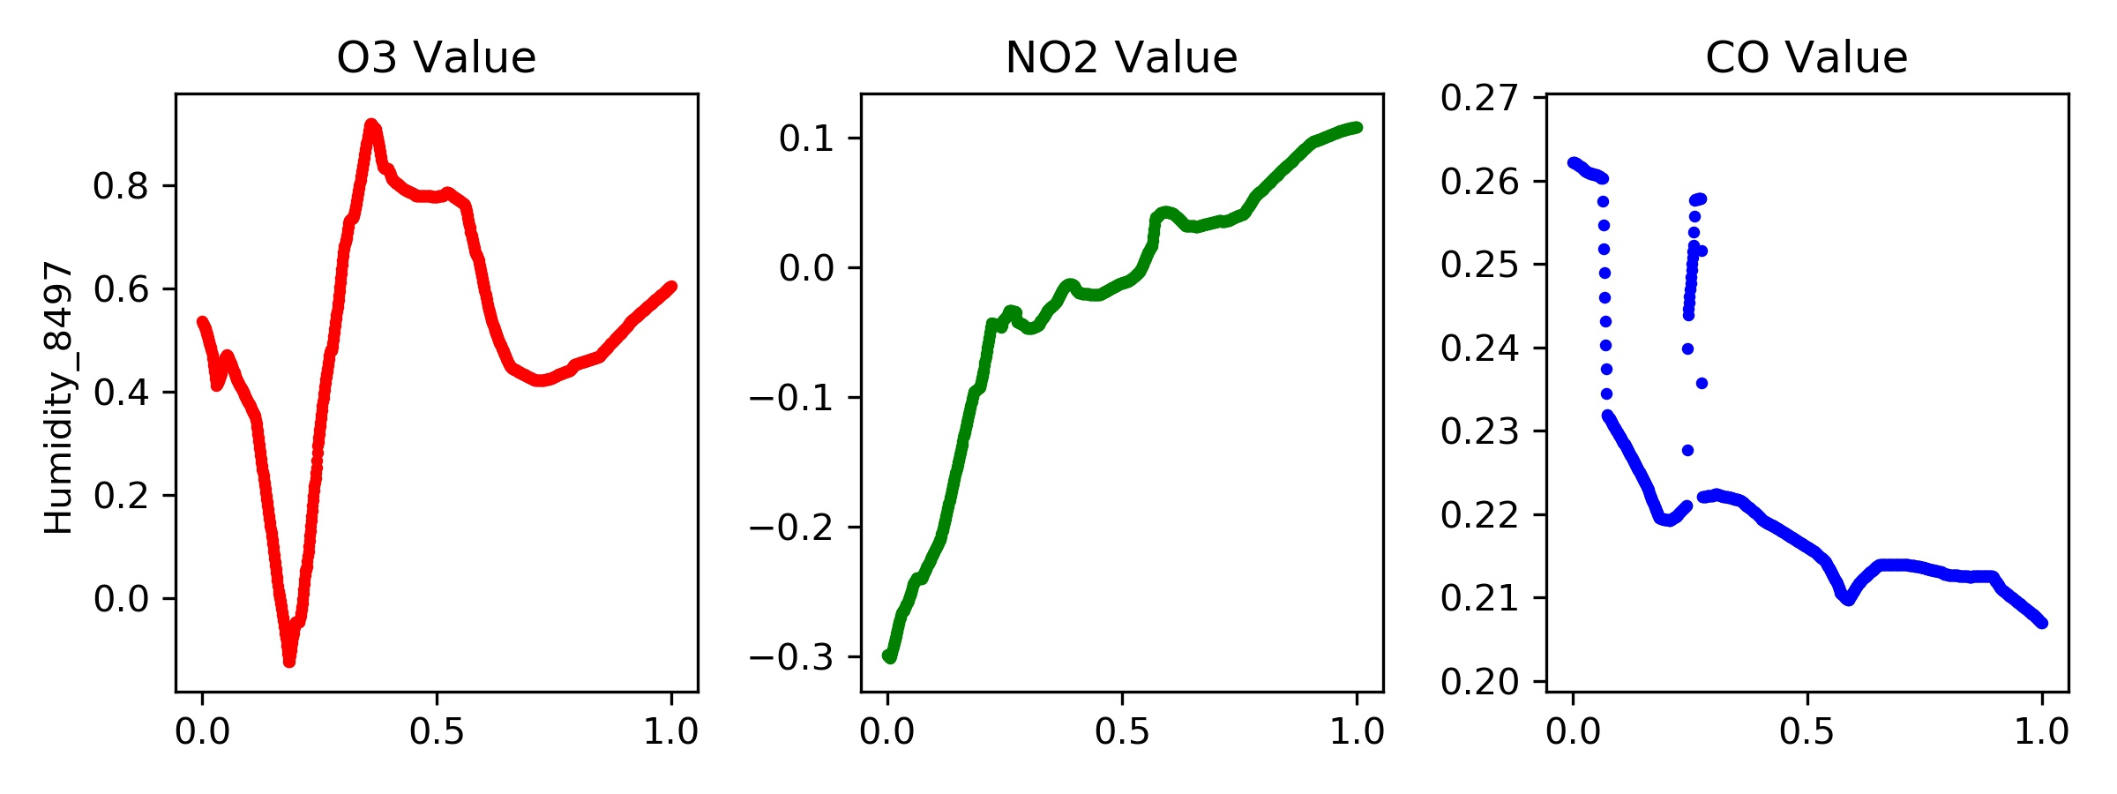
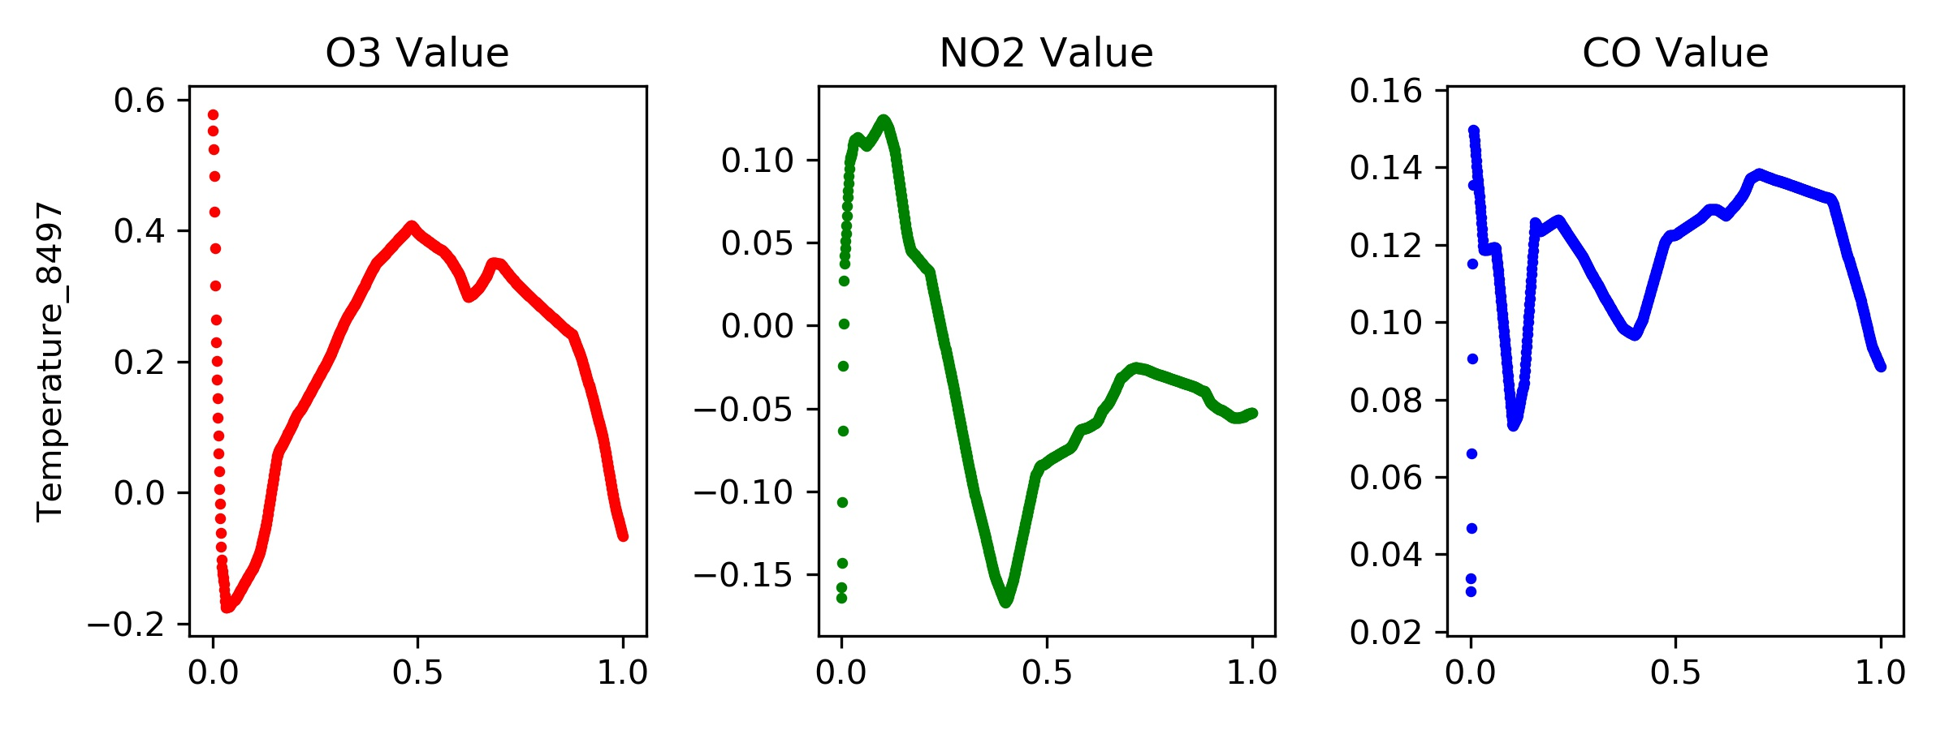
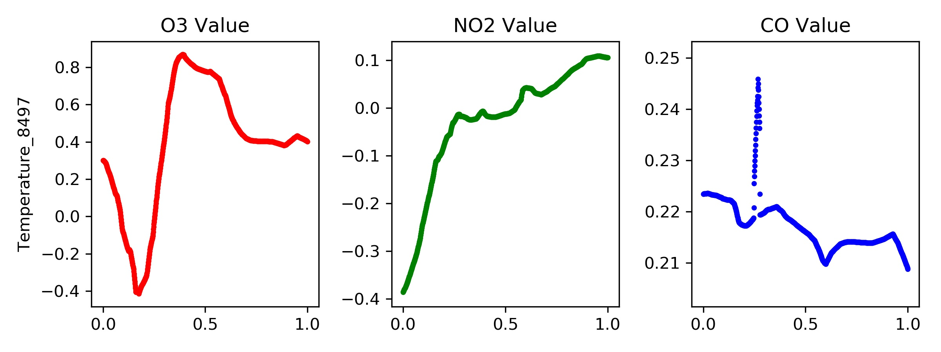
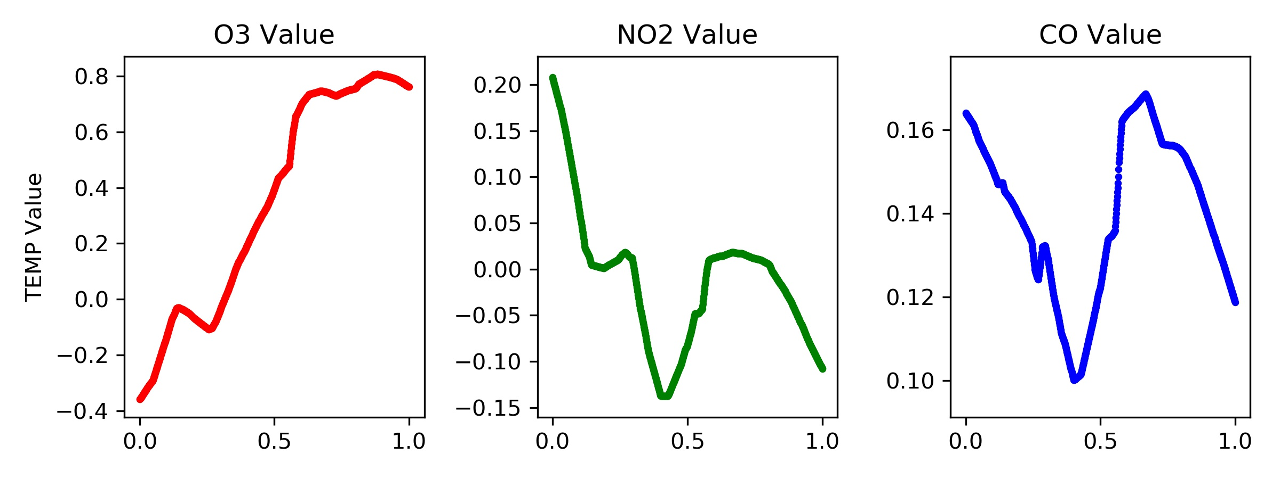
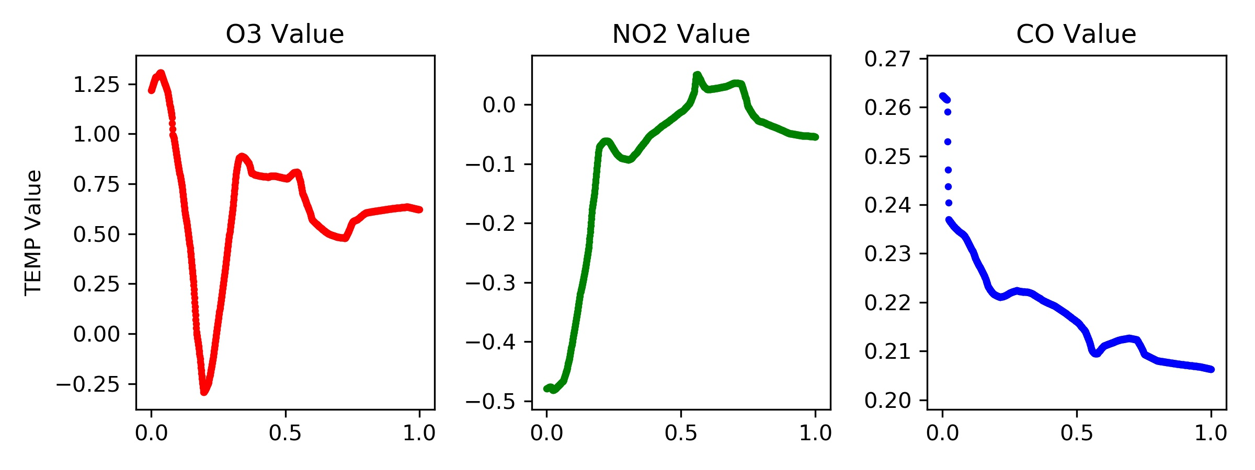
Mean Squared Error (MSE)
Mean Absolute Error (MAE)

Slide 17
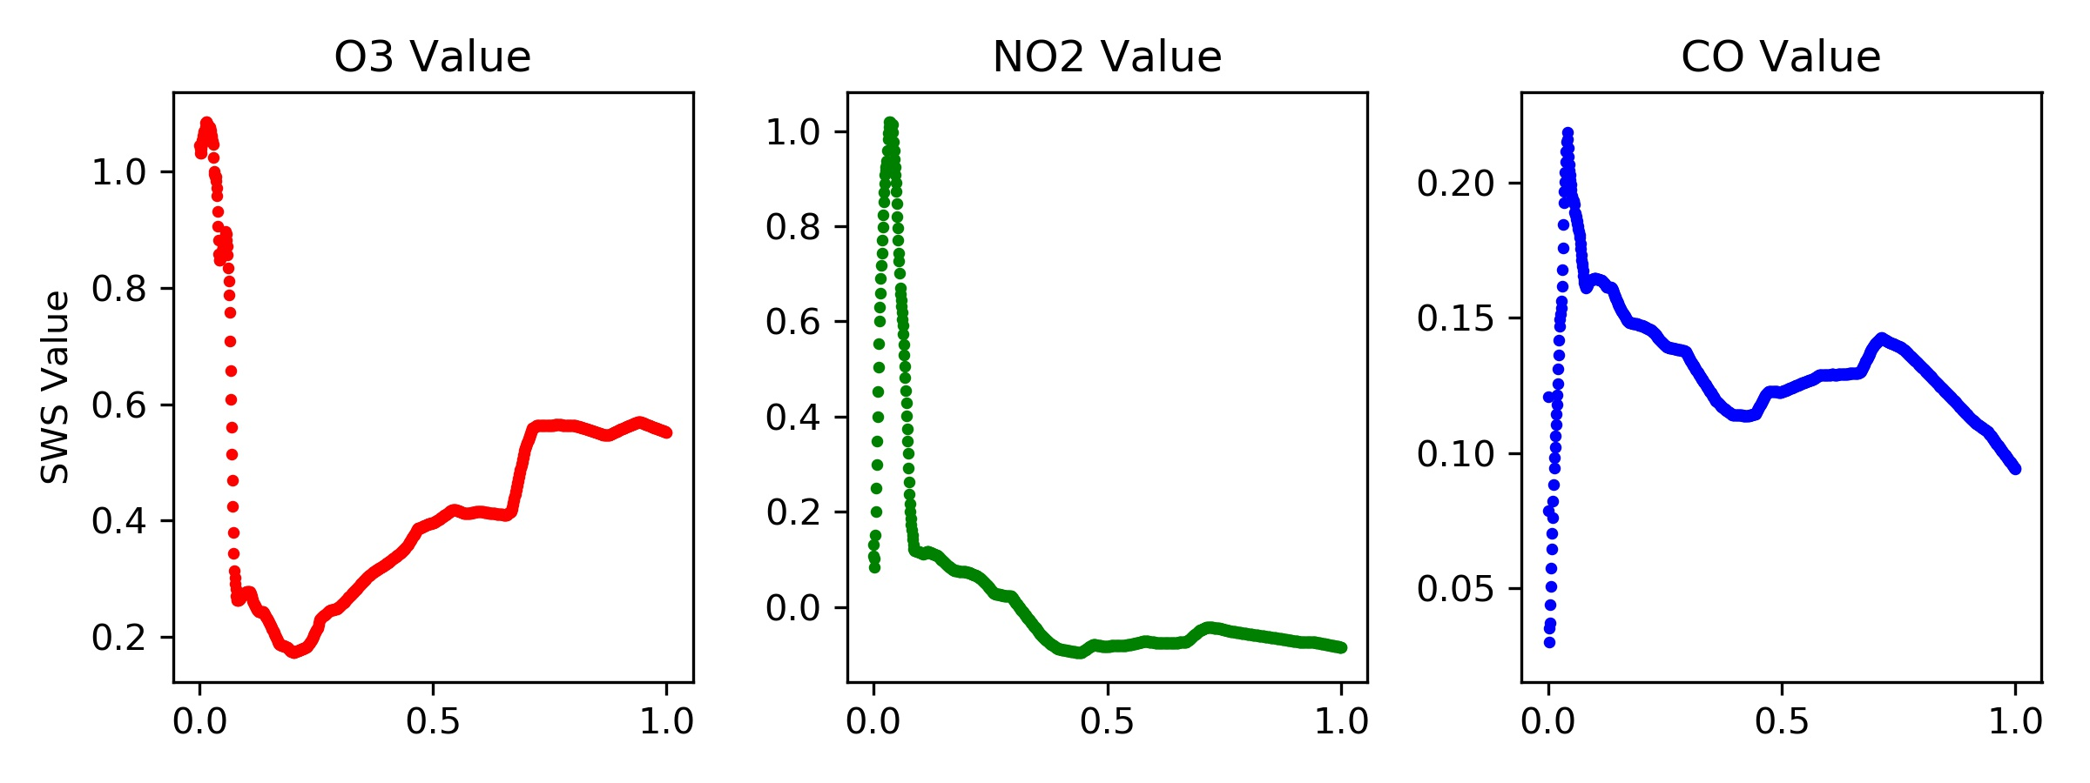
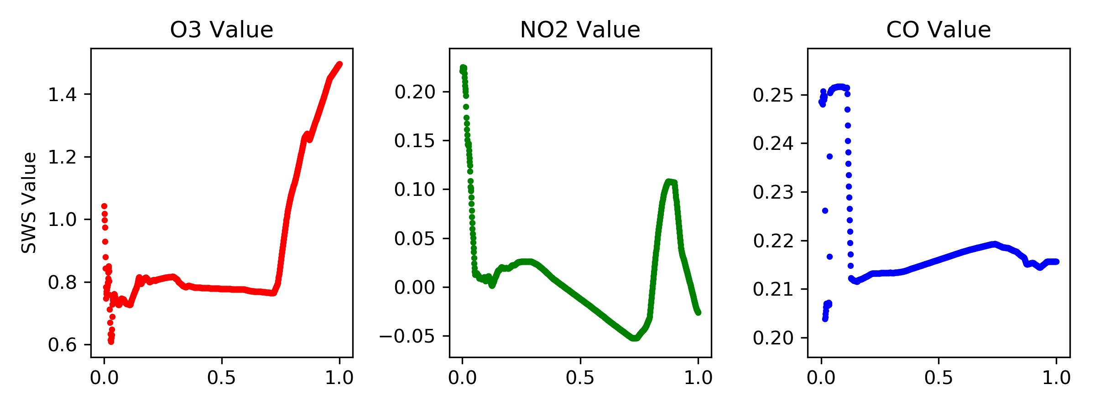
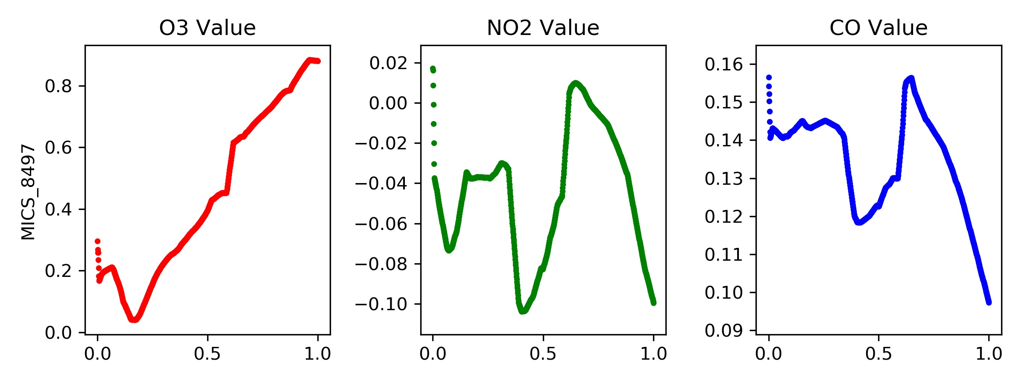
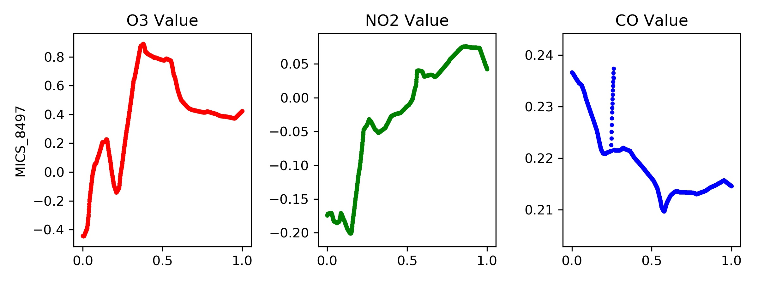
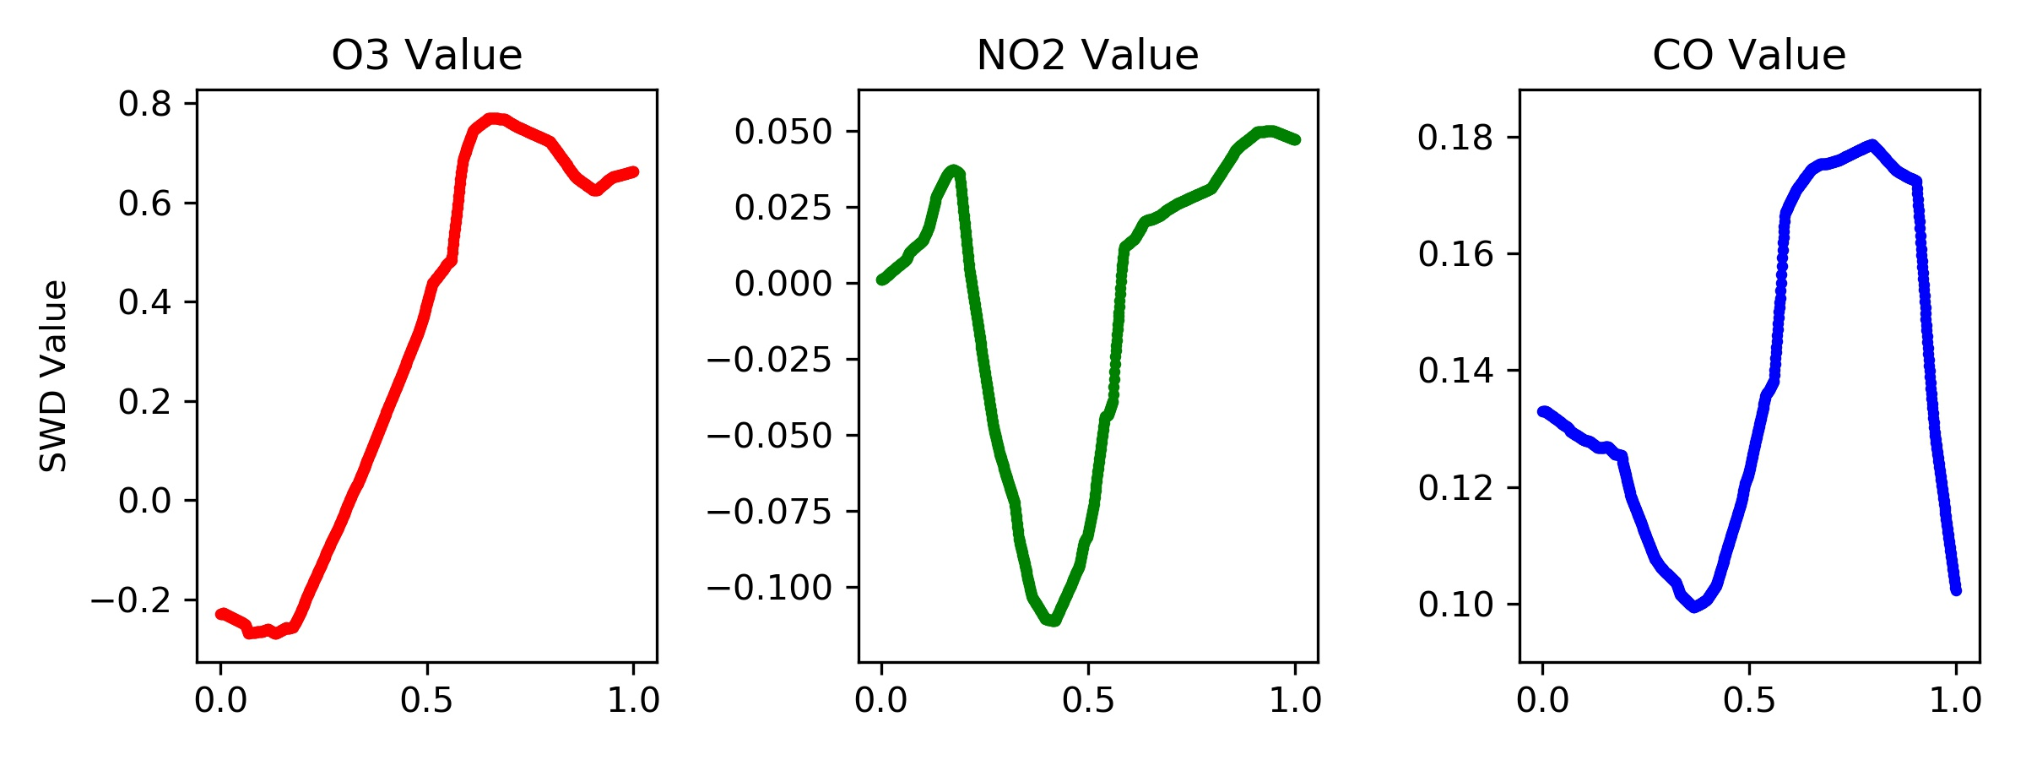
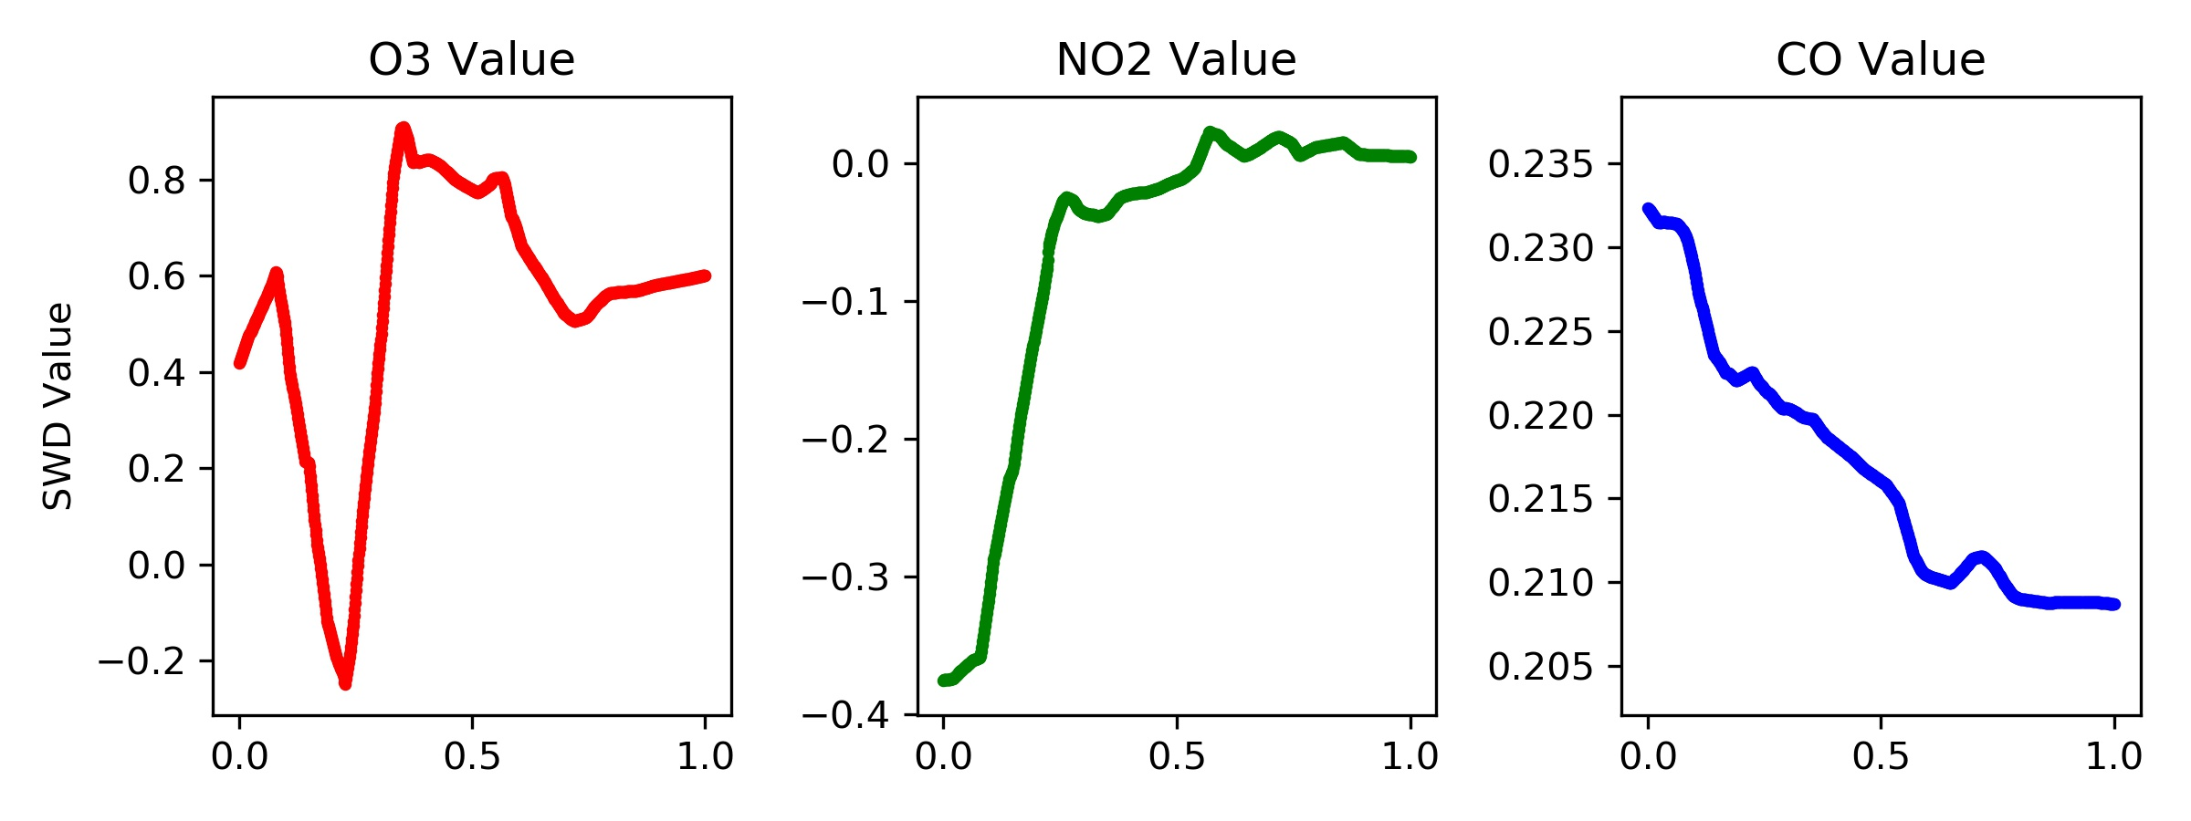
Mean Squared Error (MSE)
Mean Absolute Error (MAE)

Slide 18
“Global Neural Network”
Definitely worrisome a lot of these parameters seem to suggest that the global systems maybe overfit or seem unphysical…
MSE vs MAE definitely have a big difference in their performance
Networks trained using MAE seem to have a bit more physical, but saying that is a bit of a stretch even…

Slide 19
Greater Applications of Global Neural Network
Two datasets were omitted from the overall training/validation set can we use them to see how the “Global Neural Network” performs?

Slide 20
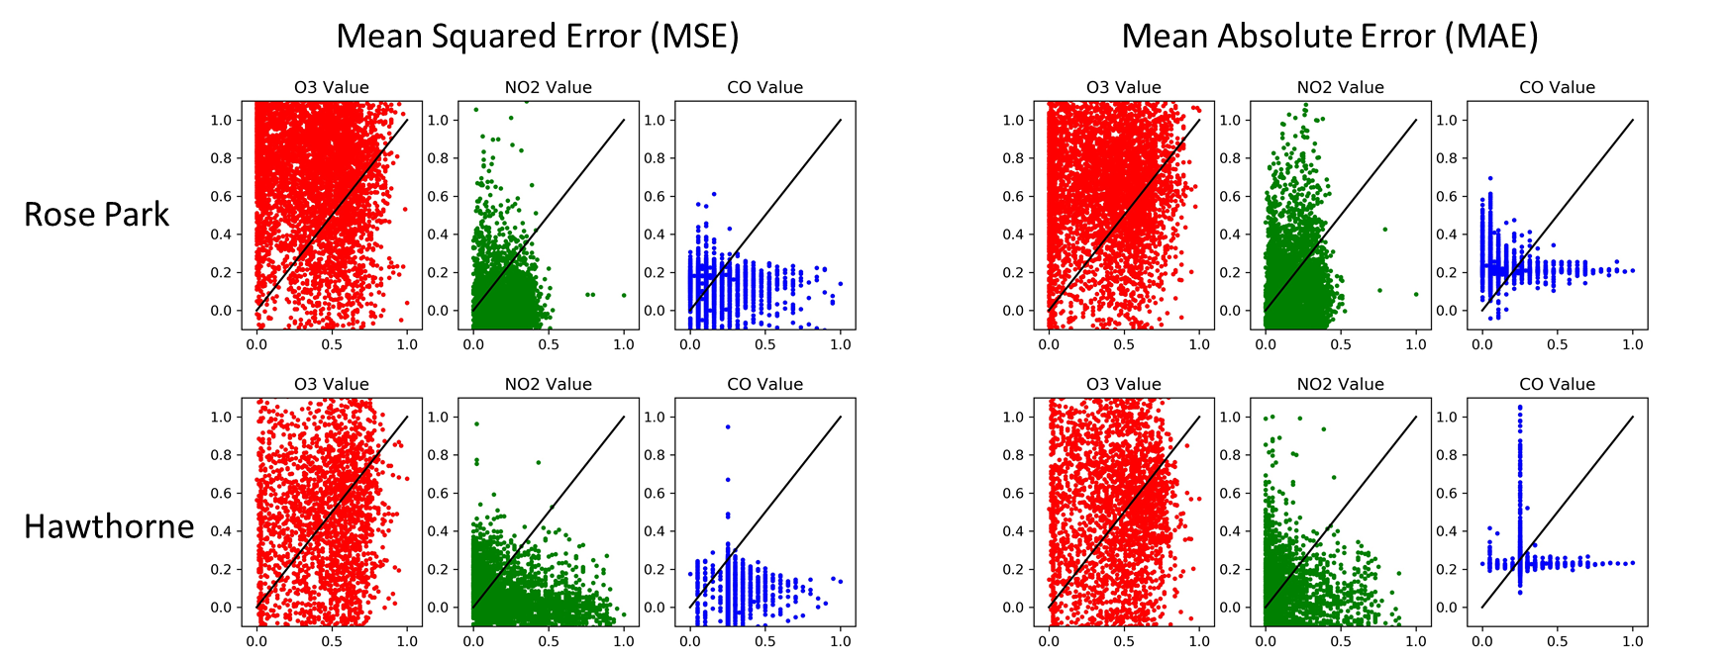
Disappointing…

Slide 21
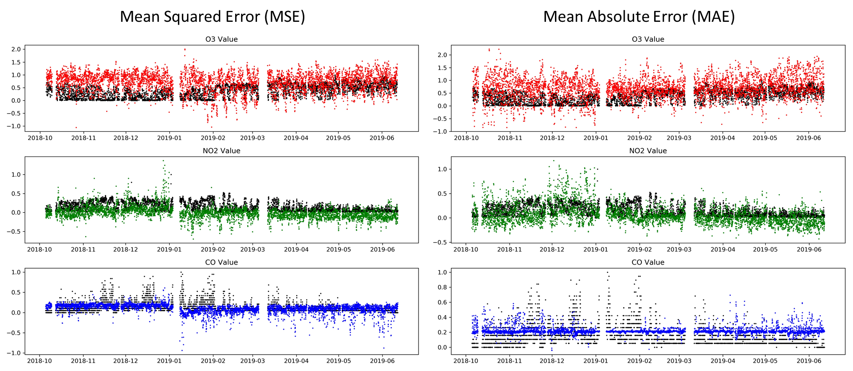
Time Series Analysis-Rose
Note that colored dots are ML predictions and black dots are DAQ values
Normalization issues?!?

Slide 22
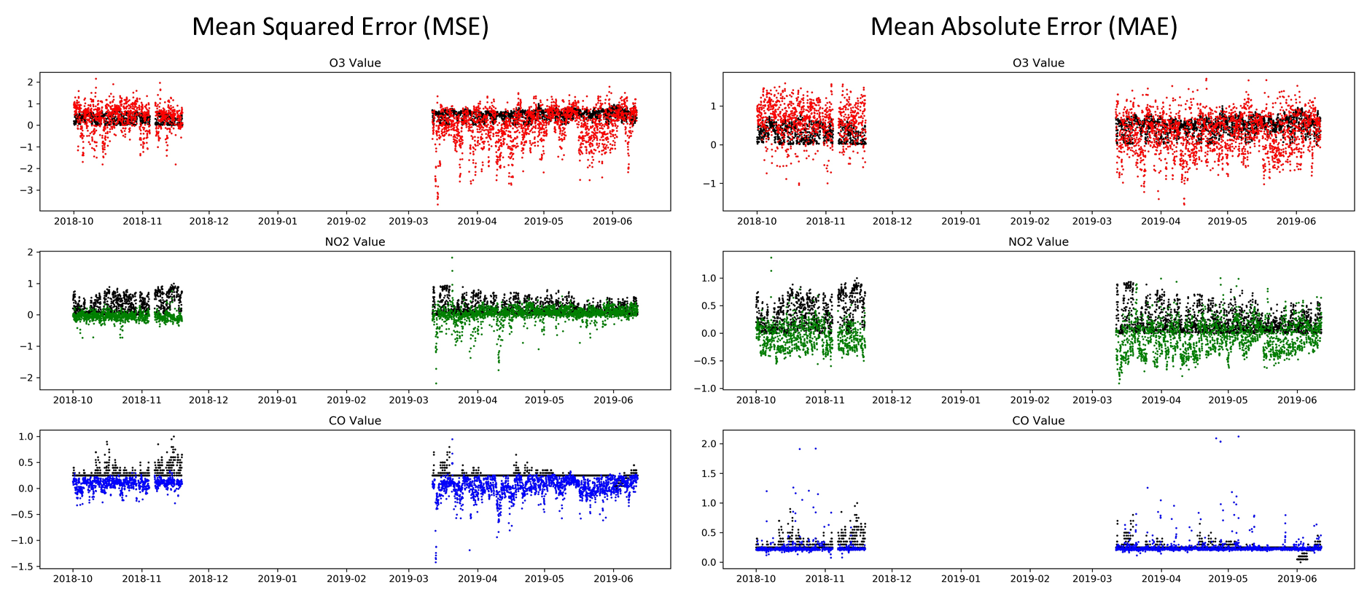
Time Series Analysis-Hawthorne
Note that colored dots are ML predictions and black dots are DAQ values
Normalization issues?!?

Slide 23
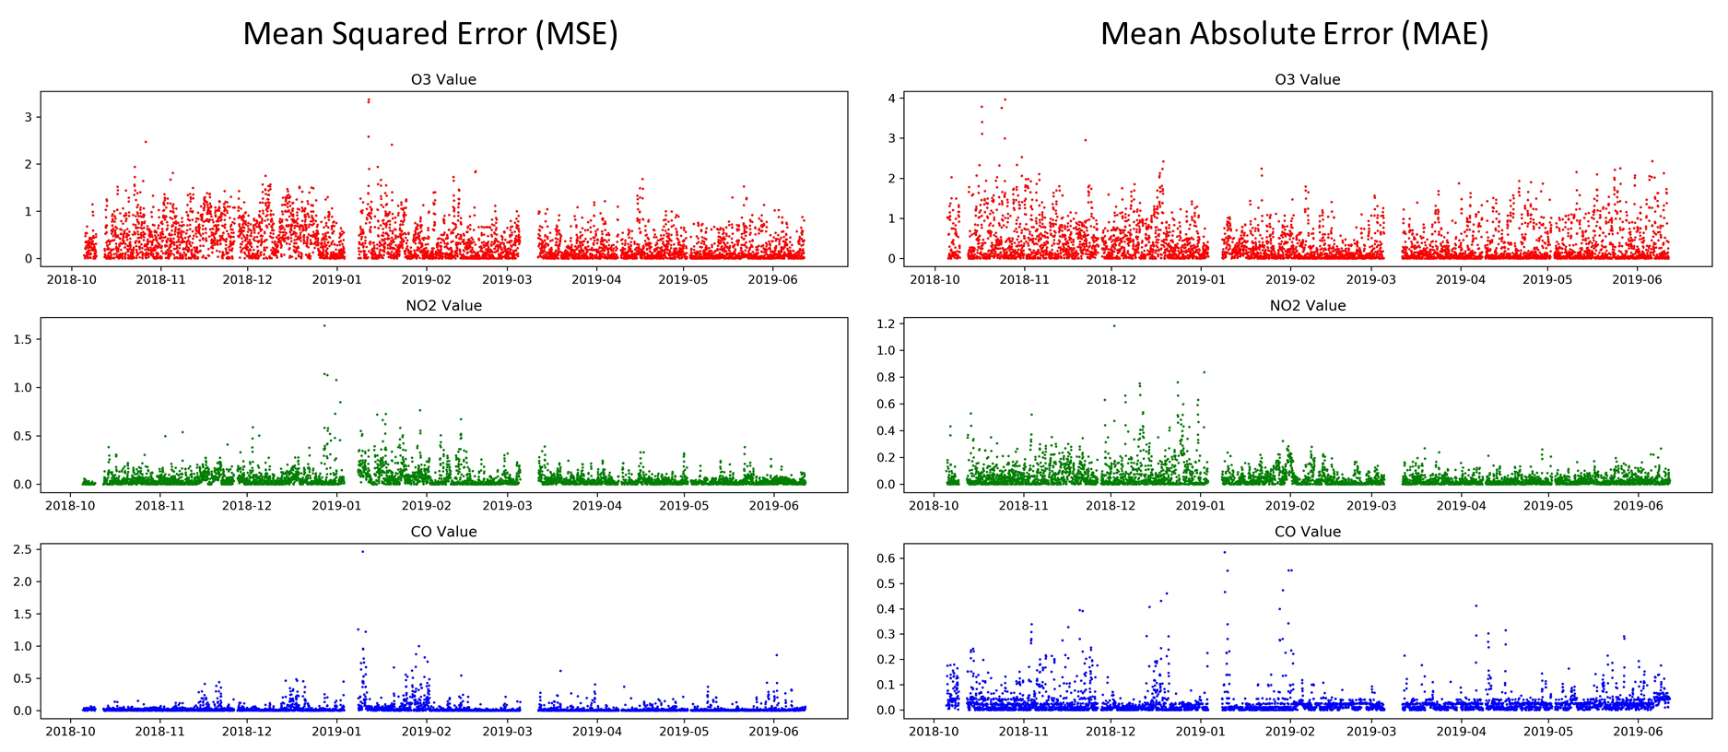
Error (L2-norm) Plots (Datetime)-Rose
Outliers may need to be filtered…

Slide 24
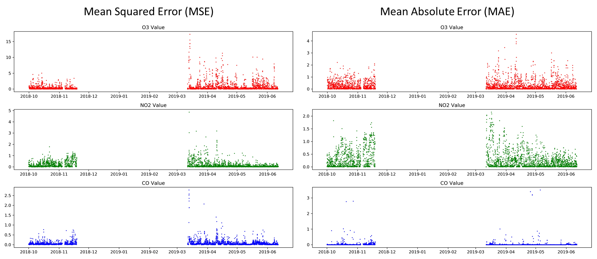
Error (L2-norm) Plots (Datetime)-Hawthorne
Again outliers may need to be filtered…

Slide 25
Conclusion
Silver Lining-Global Network seems to perform decently when normalization is performed well.
Next main direction-Improving data filtering and normalization
Other ideas- Reducing inputs may not reduce training error or r2 values, but may allow the neural network parameters have more a physical relationship that may prevent overfitting and allow the global neural network to be used on any sensor.

